Slide 1

Supply Chain Management
Adharsh P
PGA36

Slide 2
INTRODUCTION
Efficient supply chain management is vital for businesses aiming to optimize operations, reduce costs, and enhance customer satisfaction. In this project, we perform a comprehensive analysis of supply chain data, focusing on key metrics and processes to identify patterns, optimize inventory management, and improve overall performance.
My aim is to enhance the supply chain management by leveraging data analysis and predictive modeling on a dataset comprising 53 columns and 1,80,000 rows, covering sales, profits, deliveries, and inventory management.

Slide 3
Buisness PROBLEM
The company faced multiple challenges in its supply chain operations, including difficulty in identifying high-performing regions and product categories, lack of understanding of profit and loss drivers, inability to pinpoint causes of financial losses, and unclear impact of discounts on financial outcomes. Additionally, issues with late deliveries, potential fraudulent activities, inefficient inventory management, and the need to prioritize management efforts based on product value were significant concerns. There were also inefficiencies in warehouse management affecting customer satisfaction, challenges in predicting late deliveries, and the need to segment customers for targeted marketing.

Slide 4
STEPS TO SOLVE THESEPROBLEMS TO ENHANCE THE OPERATIONS
Regional and Category Insights:
Conducted in-depth analysis of regional sales data to uncover patterns and trends, enabling strategic decisions to maximize sales and profitability.
Identified top-selling product segments through detailed category analysis, informing focused marketing and inventory strategies to boost sales.
Discount Impact Evaluation: Used statistical analysis, including the bootstrap method, to assess the relationship between discounts and financial outcomes, guiding discount strategies to optimize profit and sales.
Late Delivery Insights: Analyzed delivery data to identify shipment types and factors causing delays, leading to proactive measures that improved delivery performance and customer satisfaction.
Fraud Detection: Detected anomalies in delivery patterns indicative of fraudulent activities, mitigating financial losses and enhancing trust in delivery processes.

Slide 5
INVENTORY MANAGEMENT
Inventory Management Optimization: Calculated optimal reorder points and safety stock levels for each product, ensuring efficient inventory management and reducing stockouts.
ABC Classification: Applied ABC classification to categorize products into A, B, and C classes based on their value, optimizing resource allocation for high-value items.
Market Basket Analysis: Conducted market basket analysis to identify product groupings, informing warehouse management strategies and enhancing customer satisfaction through optimized inventory placement.
RFM Analysis: Conducted RFM (Recency, Frequency, Monetary) analysis to segment customers based on purchasing behavior, allowing for targeted marketing campaigns that improved customer retention and sales.

Slide 6
DATASET OVERVIEW
Records: 180,519
Columns: 57
Type (Order type)
Days for shipping (real) (Actual days)
Days for shipment (scheduled) (Scheduled days)
Delivery Status (Order status)
Late_delivery_risk (Risk indicator)
Category Name (Product category)
Customer City (City)
Customer Country (Country)
Customer Id (ID)
Customer Segment (Segment)
Department Name (Department)
Market (Market segment)
Order Id (ID)
Order Item Discount (Discount)
Order Item Quantity (Quantity)
Sales (Sales amount)
Order Profit Per Order (Profit/order)
Order Region (Region)
Order Status (Status)
Product Name (Product)
Shipping Mode (Mode)
Order Month Year (Month year)
Profit or Loss (Indicator)
Late Delivery Risk (Risk level)

Slide 7
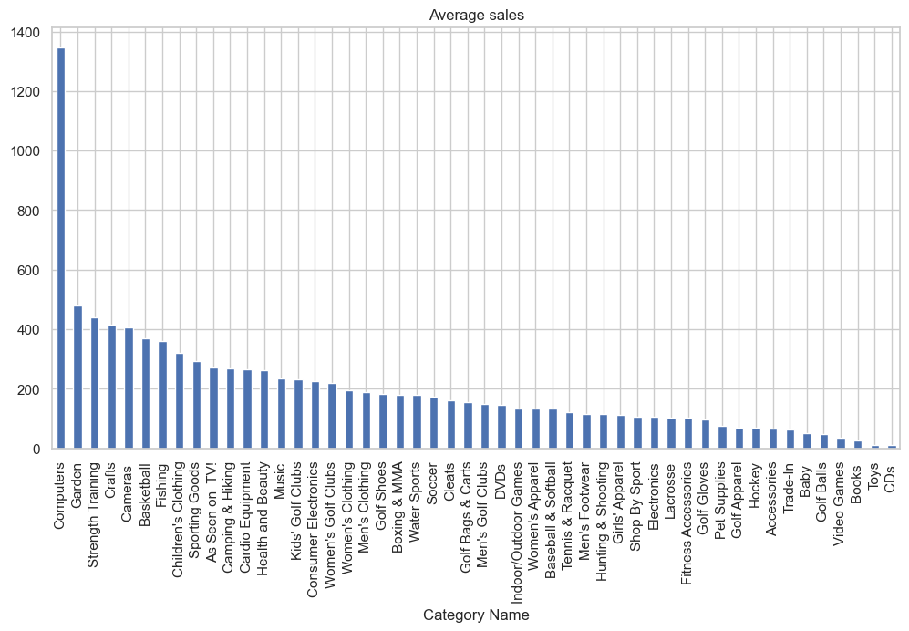
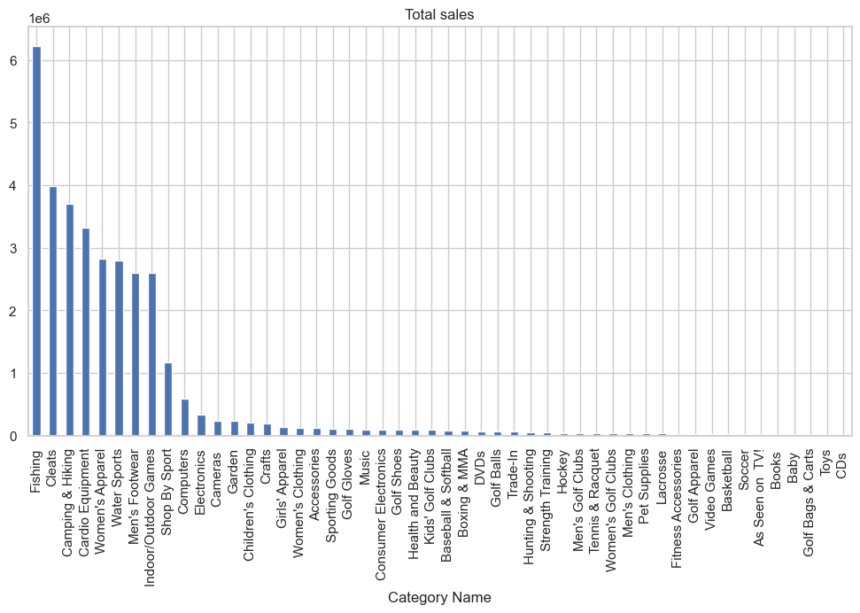
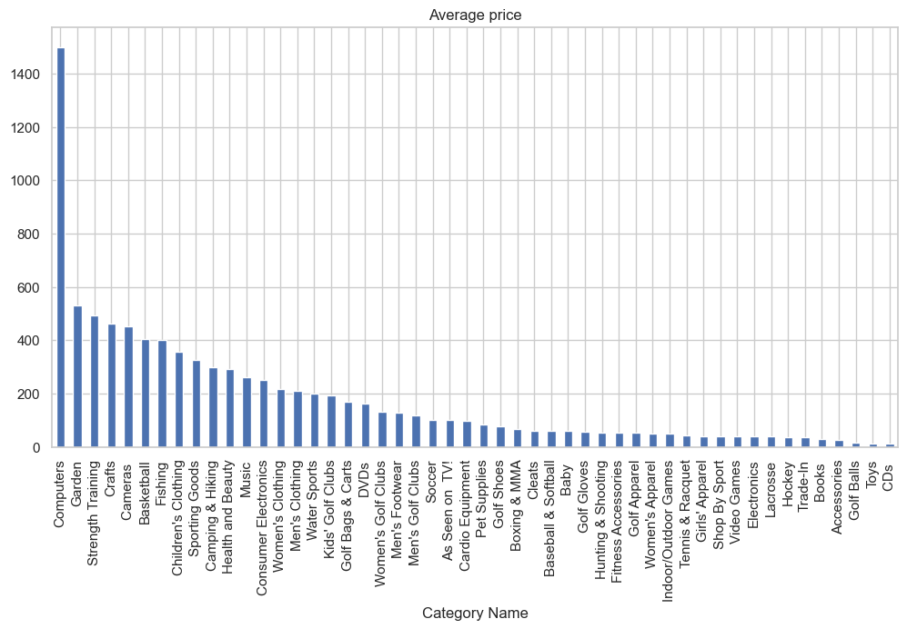
CATEGORY VS SALES

Slide 8
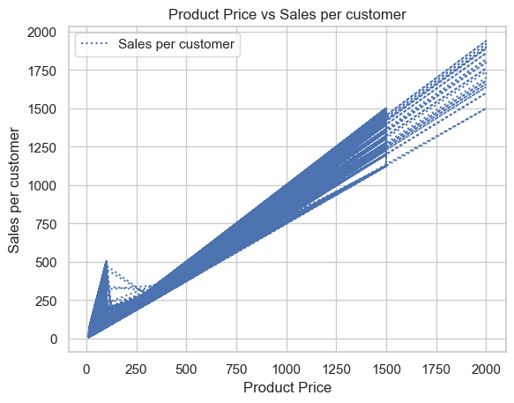
PRODUCT PRICE vs sales per customer
Fishing: Highest number of sales​
Cleats: Second highest number of sales​
High-Value Products:​
Top 7 Products: Highest average prices are also the most sold​
Computers: Nearly 1350 sales despite a $1500 price tag​
Price and Sales Relationship:​
Correlation: High correlation between price and sales​
Trend Analysis: Linear relationship observed between price and sales​
Customer Behavior: Customers tend to buy more high-quality, higher-priced products​
​
The linear relationship between price and sales indicates that customers prefer higher-quality products despite their higher prices. This suggests that strategic pricing adjustments could optimize revenue and market penetration by aligning with customer preferences for quality.
It can be observed that prices has linear relation with sales.

Slide 9
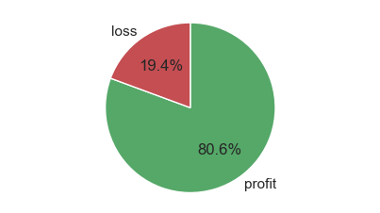
Profit and loss analysis

Slide 10
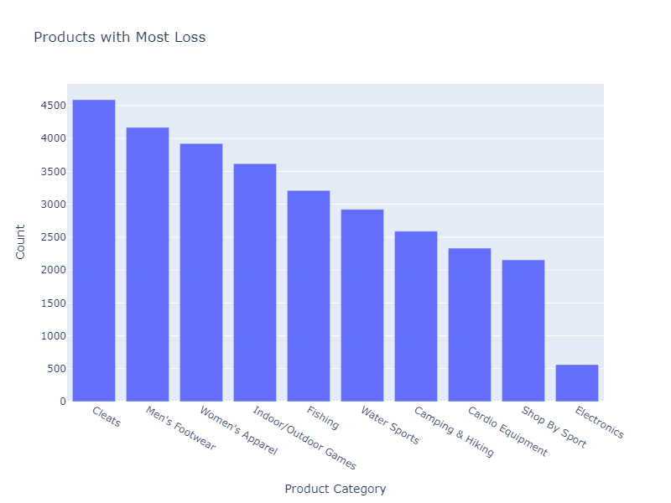
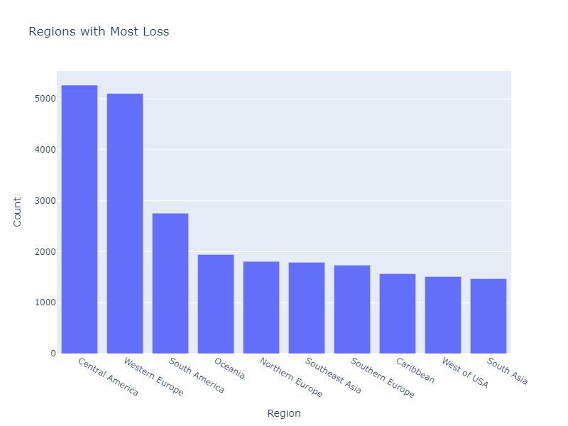
Analysis of Loss-Making ProducT CATEGORY and Regions

Slide 11
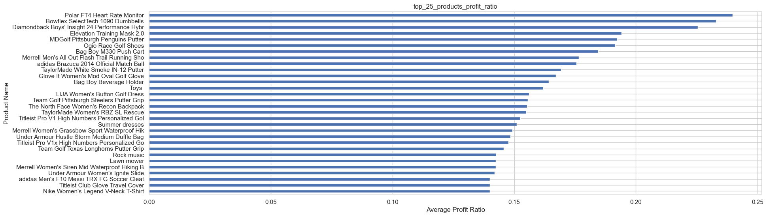
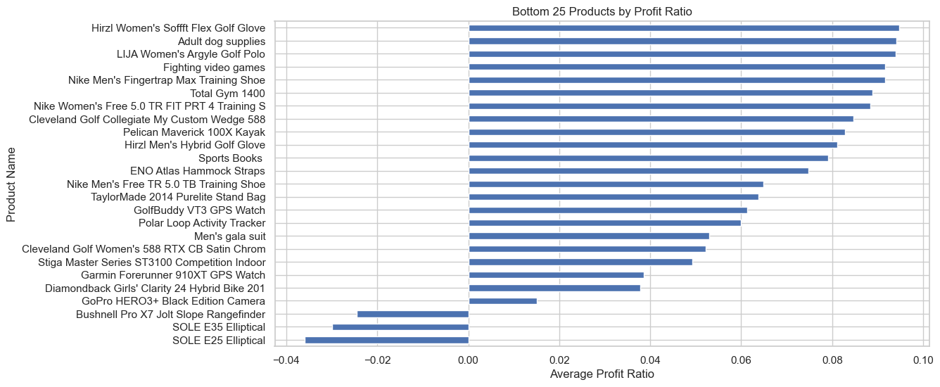

Slide 12
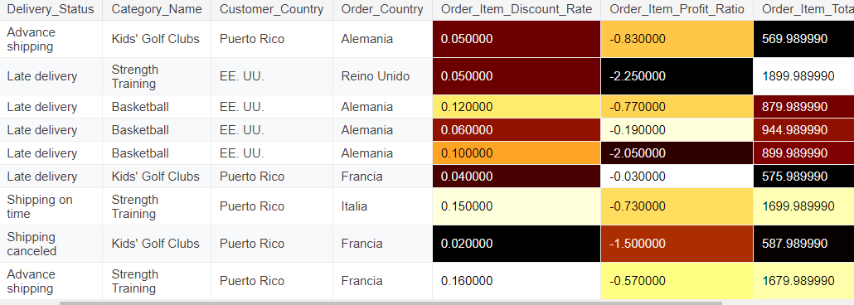
Analyzing the three loss making products

Slide 13
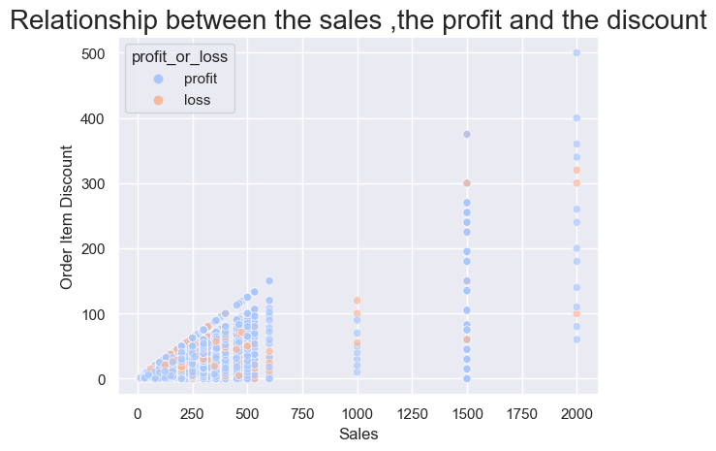
Relationship between sales, profit and discount
Null hypothesis (H0):
There is no difference in the mean discount rates between profitable and non-profitable transactions.
Alternative hypotheise:
There is a difference in the mean discount rates between profitable and non-profitable transactions.
95% Confidence Interval: [-0.2456748121798677, 0.23691721253850745]
P-value: 0.469
Fail to reject the null hypothesis. There is no significant difference in discount rates between profitable and non-profitable transactions.

Slide 14
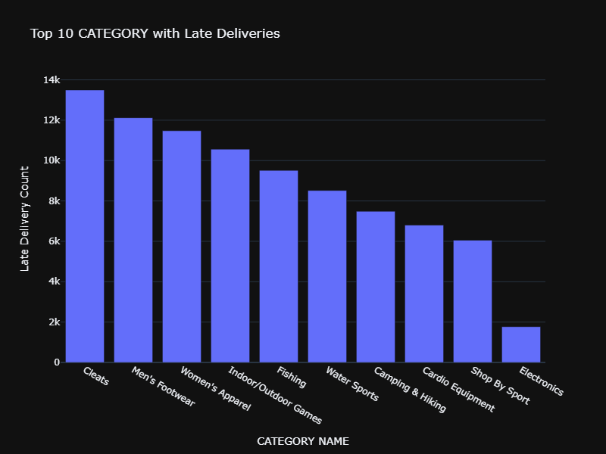
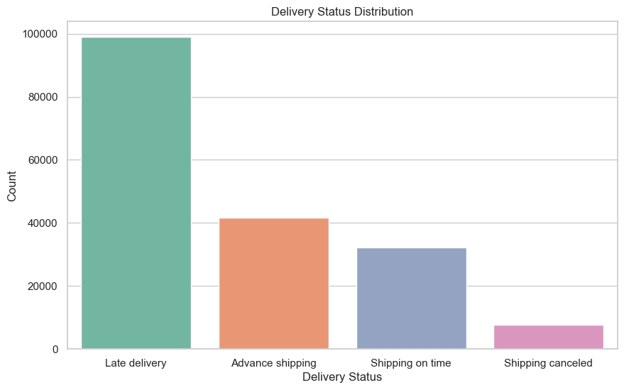
Risk Management in Delivery

Slide 15
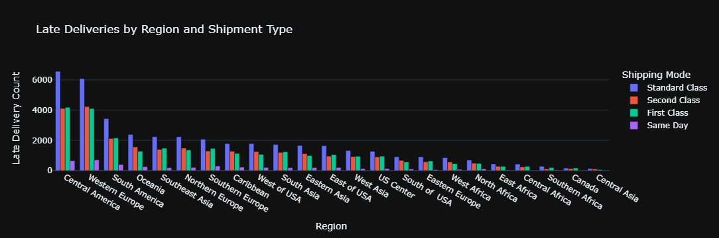
LATE DELIVERIES BY REGION AND SHIPMENT TYPE

Slide 16
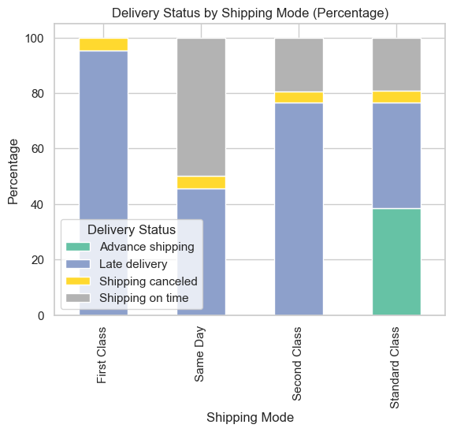
DELIVERY STAtus by shipping mode
First & Second Class: ~90% late deliveries.
Issues: Insufficient logistics, unoptimized routing, order processing delays.
Recommendation: Review logistics, optimize routing, improve processing times.
Same Day Shipping:
~50% late deliveries.
Recommendation: Proper Warehouse Mnagement
Standard Class: Standard Class shows a more balanced distribution with moderate late deliveries (50%) and a notable percentage of advance shipping (20%).
Recommendation: offer as a premium service to cutomers

Slide 17
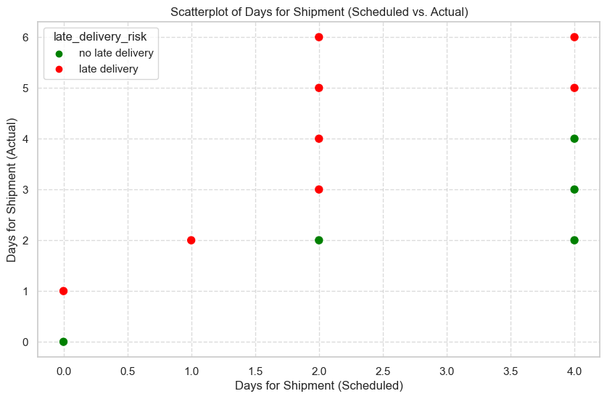
Delivery status by shipping mode
According to the chart, the orders that were scheduled to be delivered in 2 days have the highest delay. By analyzing the dataset, 2-day deliveries are related to second-class shipping modes. As a result, the highest amount of delay in delivery is related to the Second Class. Shipping Modes (Days for shipment scheduled):¶

Slide 18
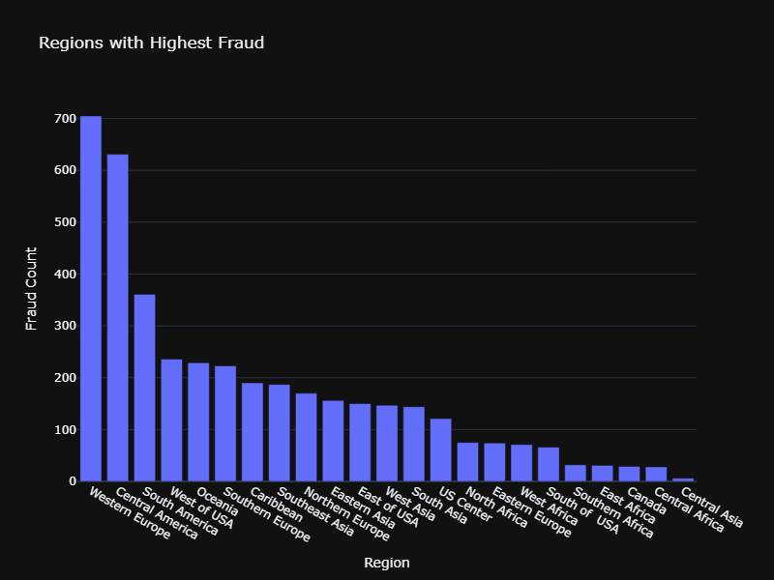
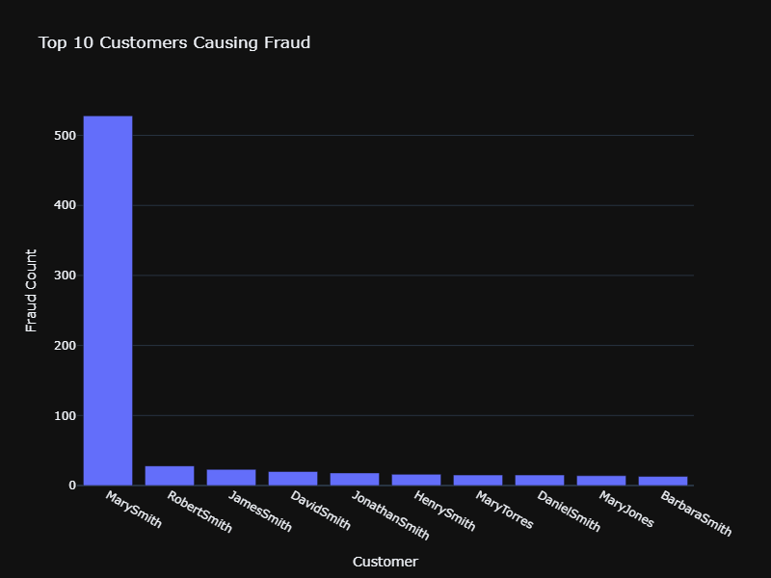
Fraud detection
The total amount was almost 102k which is very huge amount.Since Mary was using different address every time when placing orders, a new customer id was issued each time which makes it difficult to identify the customer and ban them. All these parameters should be taken into consideration to improve fraud detection algorithm so fraud can be identified more accurately.

Slide 19
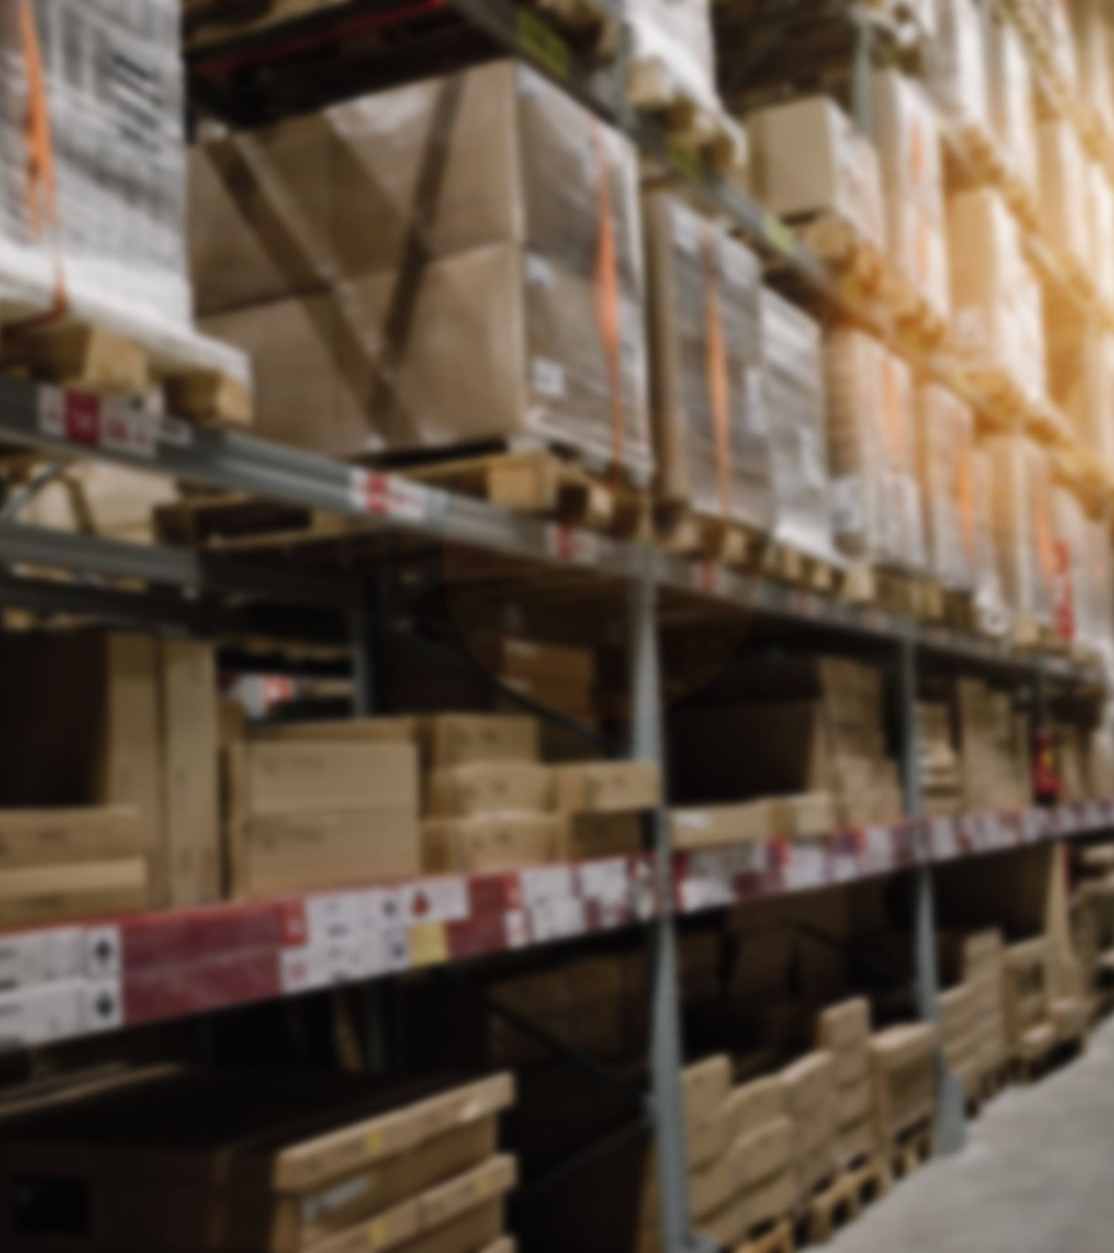
Inventory management
Effective inventory management, through the use of safety stock and reorder points, is crucial for maintaining optimal stock levels, reducing costs, and enhancing customer satisfaction. It supports strategic decision-making and ensures business continuity in the face of supply chain uncertainties.
Safety Stock =𝑍 × StdDevDemand×sqrt(LeadTime)
Z is the Z-score corresponding to the desired service level (e.g., 95%).
Reorder Point=(LeadTime×DemandRate)+Safety Stock

Slide 20
CALCULATION OF SAFETY STOCK
Caluclate the average monthly demand of each product
Calculate the variability ion demand.The mathematical term for this is standard deviation. In simple language, it captures the difference between the actual monthly demand and the average monthly demand. Take the square of each month's difference, then average those squares together. That average is known as the variation.
Calculate the lead time for each product, in this case the lead time is the time taken for delivery.
Now assign z score based on waht levelk of confiedence we require.The Z-score is a way of deciding how confident you want to be about having enough stock
Re-order point is the threshold you maintain such that, if the stock level falls to this level, you raise a new purchase order with your supplier. )nd.

Slide 21
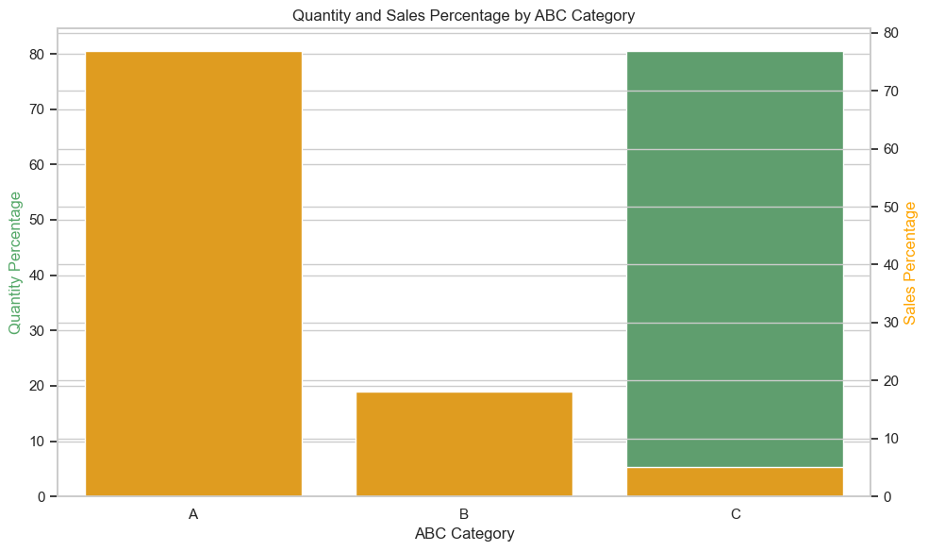
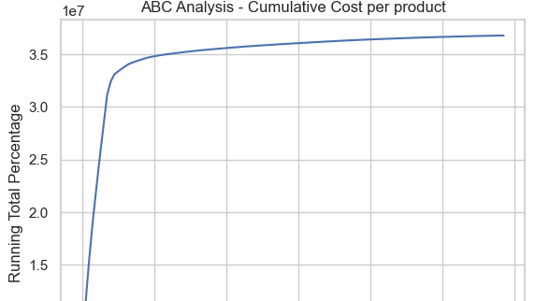
ABC CLASSIFICATION OF PRODUCTS
In my inventory, a significant portion of sales—approximately 80%—is generated by just 7 high-value products. These products fall under the A category in the ABC classification. On the other hand, the C category products, which constitute about 80% of the total products, contribute to less than 10% of the sales.
By classifying inventory in this manner, I can prioritize management and optimization efforts on the A class products, ensuring they have the best Safety Stock levels. This approach helps in efficiently allocating resources, reducing stockouts, and maintaining high service levels for the most critical items in the inventory.

Slide 22
Data processing
Observation:
After "02-10-2017 12:46:00", all recorded customers in the system are new. There are no records of old customers purchasing after this date and time.
Possible Explanation:
This irregularity could be due to a change in the system handling customer data. The company might have started using a different system for old customers while continuing to use the same system for new customers.
Action Required:
Consult with data engineers or data owners to understand the exact reason behind this data anomaly.
For rfm analysis we remiove the dataa after the time stamp .

Slide 23
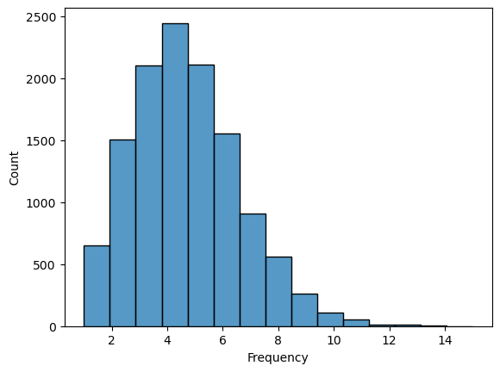
Frequency analysis
Quantile Division: Divided the customer order frequencies into three quantiles:
First 33%: Total purchases between 1 and 3.
Next 33% (33-66 percentile): Total purchases between 3 and 5.
Final 33%: Total purchases between 5 and 15.
Scoring System:
Assigned scores based on purchase frequency:
Score 1: Frequency between 1-3.
Score 2: Frequency between 3-5.
Score 3: Frequency between 5-15.
Insight:
Higher frequency indicates higher value generation for the store, thus a higher score is better.
50% of our customers have ordered from us 4 times or more.

Slide 24
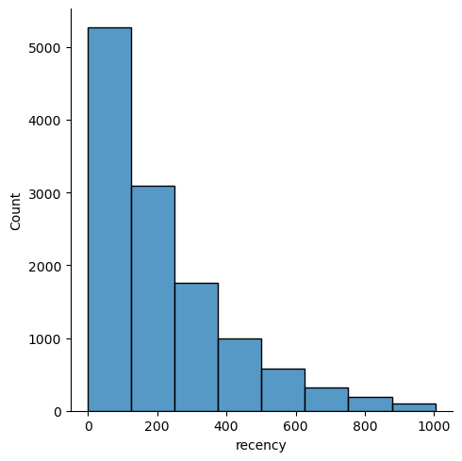
recency
We can observe that around 5250 of our customer have purchased from us in the last three months.

